Slide 1
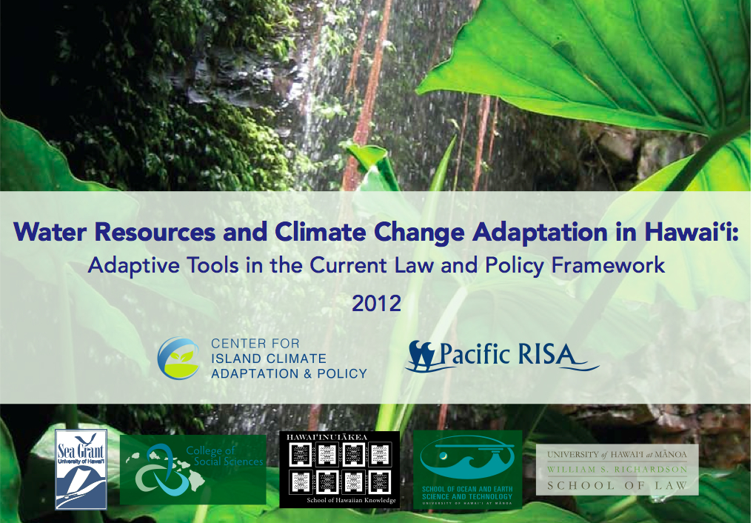

Slide 2
“Prudent water resource planning should consider the long-term impacts of global climate change and how this could affect Hawaii’s water supplies . . . .”
State of Hawai‘i Commission on Water Resource Management, 2008
“Investing in the protection of fresh water sources must be the highest priority for Hawaii’s public leaders and the Department of Land and Natural Resources.”
Gov. Neil Abercrombie, 2011

Slide 3
What Is “Adaptation”?
Do laws, policies, and procedures account for climate trends, variability, and uncertainty?
(2) In the future, will we have the flexibility to act on new information from climate scientists?
(3) Do we routinely consider how the future climate may affect the outcomes of decisions, and use that understanding to make more informed decisions?

Slide 4
Four Adaptive Elements
Adaptation recognizes uncertainty, and addresses it with these elements:
Forward-looking
1
Flexible
2
Integrated
3
Iterative
4

Slide 5

Hawai‘i Constitution
Public Trust Doctrine
Precautionary Principle
Water Code and Water Commission
Haw. Water Plan
Land Use Regulation and Planning
Watershed Protection
Recycling and Conservation
County Bds. Water Supply
Haw. Dep’t of Health
Haw. Dep’t Agric.
Individual, Business, and Gov’t Water Users

Slide 6
Sample Adaptive Mandates
“Protect” water resources for the benefit of “present and future generations.”
“Establish procedures for regulating all uses of Hawaii’s water resources.”
“Must conform to changing needs and conditions.”
“Continuing study” of salt-water intrusion.
Forward-looking
Flexible
Integrated
Iterative
1
2
3
4

Slide 7
Implementation Tools?
Hawai‘i Constitution
Public Trust Doctrine
Precautionary Principle
Water Code and Water Commission
The Water Commission is empowered to “consider, protect, and advance public rights at every stage of the planning and decisionmaking process.”
Forward-looking
Flexible
Integrated
Iterative
1
2
3
4

Slide 8
Policy & Planning Tools
Hawai‘i Water Plan
(1) Climate scenario planning
(2) Update regularly (5-year interval / 40-year planning horizon)
(3) Integrate land use planning with water availability (e.g. Maui WAP)
(4) O‘ahu watershed management planning
(5) Conservation and recycling plans
Forward-looking
Flexible
Integrated
Iterative
1

Slide 9
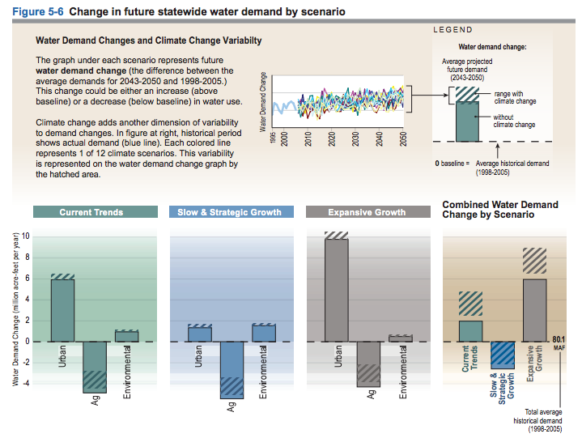
Climate scenario planning
1
2
Forward-looking
Flexible
Integrated
Iterative
1
2
3
4

Slide 10

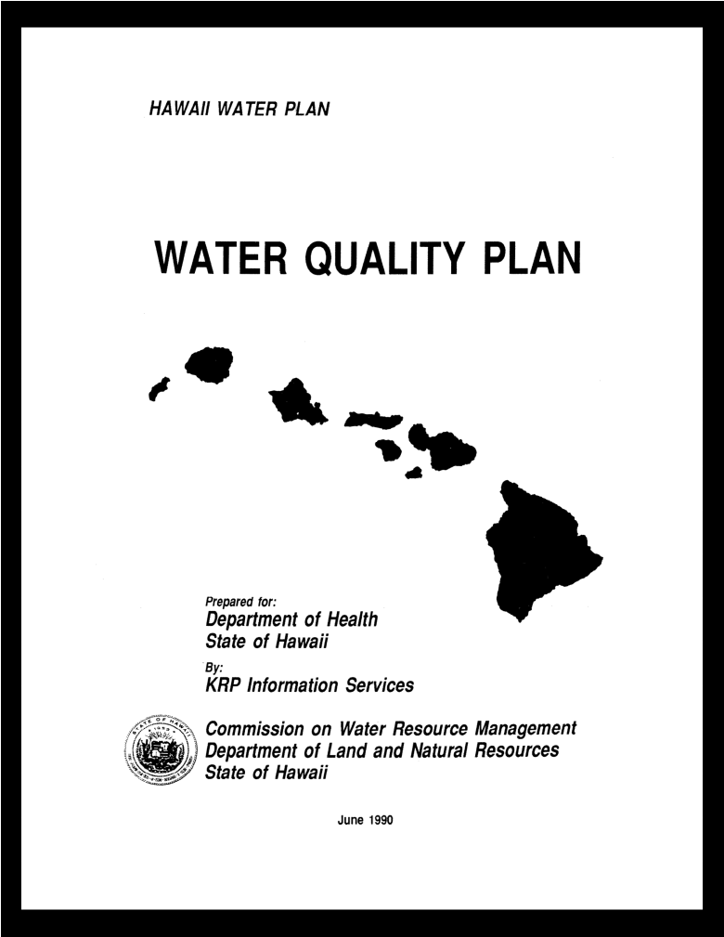
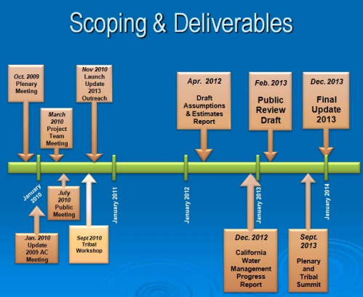
Regular updates
2
1990
Forward-looking
Flexible
Integrated
Iterative
1
2
3
4

Slide 11
Adaptive Land Use
Planning
3
Aquifer | SY (mgd) | Max. Projected Demand (Gen. Plan) (mgd) | Max. Projected Demand (Zoning) (mgd)
W Mauna Kea | 24 | 151 | 187
Kohala | 154 | 174 | 208
SW Mauna Loa | 130 | 143 | 123
NW Mauna Loa | 30 | 89 | 18
Hualalai | 56 | 282 | 115
Forward-looking
Flexible
Integrated
Iterative
1
2
3
4

Slide 12
Adaptive Land Use
Planning
3
Maui Water Availability Policy
M.C.C. § 14.12.040
“No subdivision shall be approved, unless . . . the director shall provide written verification of a long term, reliable supply of water.”
Forward-looking
Flexible
Integrated
Iterative
1
2
3
4

Slide 13
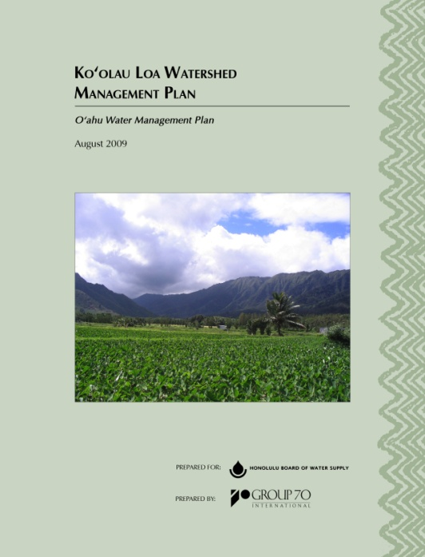
Integrated Watershed Management
4
Honolulu Water Use and Development Plan
Forward-looking
Flexible
Integrated
Iterative
1
2
3
4

Slide 14
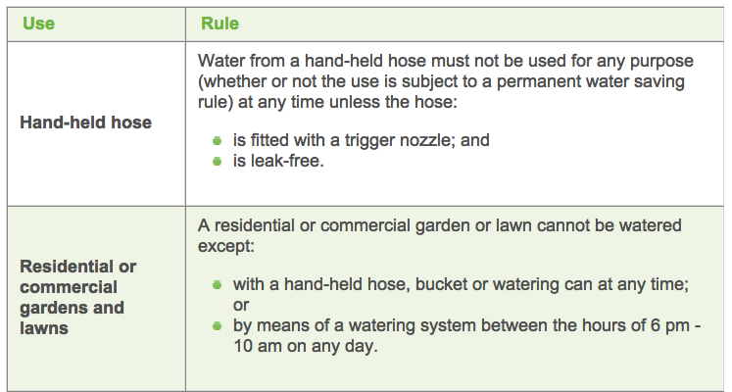
Conservation & Recycling Plans
5
E.g. Melbourne Permanent Water Saving Rules
Forward-looking
Flexible
Integrated
Iterative
1
2
3
4

Slide 15
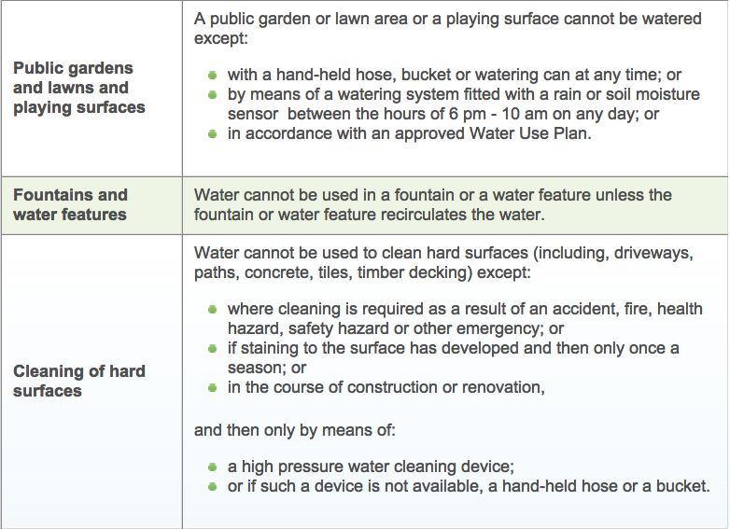
Conservation & Recycling Plans
5

Slide 16
Regulatory Tools
(6) Climate-conscious “clearly sustainable yield” and instream flow standards
(7) Enforce water use monitoring and reporting
(8) Expand designated water management areas
(9) Adaptive permitting, e.g. water use, well-construction, stream diversion

Slide 17
Climate-Conscious Sustainable Yield and Instream Flow
6
“Maximum Sustainable Yield”
vs.
“Clearly Sustainable Yield”
Forward-looking
Flexible
Integrated
Iterative
1
2
3
4

Slide 18
Enforce Monitoring & Reporting Requirements
7
Use Reporting: 67% Non-compliance
- 36% did not properly identify the location of the water source or end use
- 13% overpumping
- 12% not investigated “because of a complete lack of response from permit holders” (1 federal agency, 3 state agencies, 4 county departments, 19 corporations)
- 37% lacked an approved flowmeter
Forward-looking
Flexible
Integrated
Iterative
1
2
3
4

Slide 19
Expand Designated Water Management Areas
8
Hawai‘i Supreme Court:
Irrespective of “how many or how few of the criteria are applicable, the Commission shall designate an area as a WMA ‘when it can be reasonably determined...that the water resources in an area may be threatened by existing or proposed withdrawals or diversions of water.’”
Forward-looking
Flexible
Integrated
Iterative
1
2
3
4

Slide 20
Adaptive Permitting
9
For example:
Gauges as a standard permit condition?
Compliance inspections and fee?
“Living permit” model?
Deep monitor wells?
U.S.G.S. 2010
Forward-looking
Flexible
Integrated
Iterative
1
2
3
4

Slide 21
Market-Based Tools
(10) Green building / Hawai‘i Energy Plan model
(11) Tie Water Commission fees more closely to the cost of regulation
(12) Public goods charge / property tax model

Slide 22
Promote Water-Conscious Infrastructure
10
Forward-looking
Flexible
Integrated
Iterative
1
2
3
4

Slide 23
Water Commission Fees
11
Flat $25 application fee
vs.
Tiered fees, tied to quantity of water impacted, and cost of watershed protection necessary to protect the resource
Forward-looking
Flexible
Integrated
Iterative
1
2
3
4

Slide 24
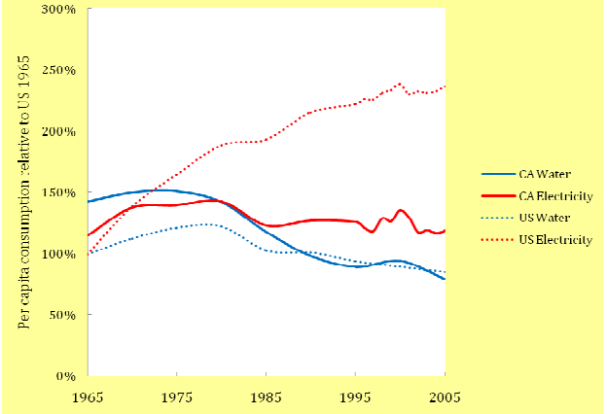
Public Goods Charge
12
U.C. Berkeley / California PUC
Forward-looking
Flexible
Integrated
Iterative
1
2
3
4

Slide 25
Let’s get started . . .

Slide 26
Hawai‘i Constitution
“Protect” water resources for the benefit of “present and future generations.”
1
“Establish procedures for regulating all uses of Hawaii’s water resources.”
3
Forward-looking
Flexible
Integrated
Iterative
1
2
3
4

Slide 27
Public Trust Doctrine
“The policy of comprehensive resource planning [is] intrinsic to the public trust concept.” “Applies to all water resources without exception or distinction.”
1
3
“Requires planning and decisionmaking from a global, long-term perspective.”
1
“Must conform to changing needs and conditions.”
2
4
Forward-looking
Flexible
Integrated
Iterative
1
2
3
4

Slide 28
Precautionary Principle
“[W]here there are present or potential threats of serious damage, lack of full scientific certainty should not be a basis for postponing effective measures to prevent environmental degradation. Awaiting certainty will often allow for only reactive, not preventative, regulatory action.”
1
“Regulators such as the Commission must be accorded flexibility [to take]regulatory action to prevent harm, even if the regulator is less than certain that harm is otherwise inevitable.”
2
Forward-looking
Flexible
Integrated
Iterative
1
2
3
4

Slide 29
Water Code
“Program of comprehensive water resources planning to address the problems of supply and conservation of water.”
3
Promote “maximum beneficial use.”
Ensure adequate “preservation and enhancement” of water resources.
1
“Continuing study” of salt-water intrusion
4
Forward-looking
Flexible
Integrated
Iterative
1
2
3
4

